Slide 1

Machine Learning 101
Session 6: Naïve Bayes Classifier
Nafis Neehal, Lecturer, CSE, DIU.
Cognota.ai

Slide 2
Contents
What is Naïve Bayes Classifier?
Application
Implementation on a Simple Dataset
Implement on Dataset From Kaggle
Cognota.ai

Slide 3
Naïve Bayes Classifier
Applies Bayes theorem to find out the likelihood of occurring the given event
Cognota.ai

Slide 4
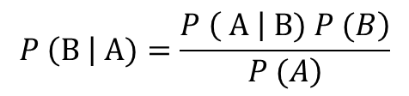
Bayes Theorem
$$P \left(B \right| A)=\frac{\left.P \left( A \right| B) P (B\right)}{\left.P (A\right)}$$
Cognota.ai

Slide 5
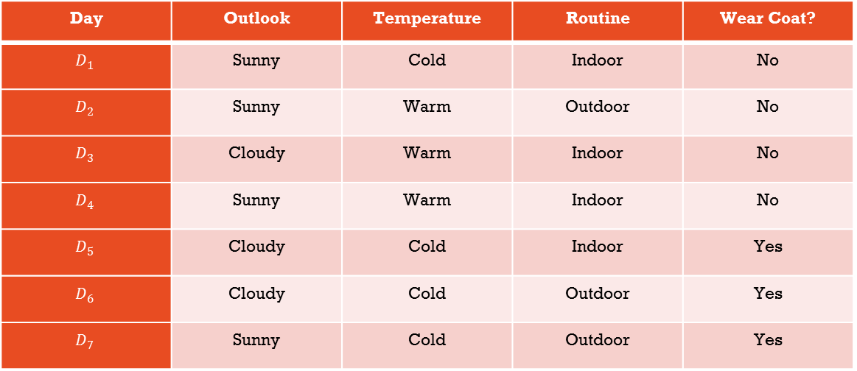
Hypothetical Dataset
Day | Outlook | Temperature | Routine | Wear Coat?
$$D_{1}$$ | Sunny | Cold | Indoor | No
$$D_{2}$$ | Sunny | Warm | Outdoor | No
$$D_{3}$$ | Cloudy | Warm | Indoor | No
$$D_{4}$$ | Sunny | Warm | Indoor | No
$$D_{5}$$ | Cloudy | Cold | Indoor | Yes
$$D_{6}$$ | Cloudy | Cold | Outdoor | Yes
$$D_{7}$$ | Sunny | Cold | Outdoor | Yes
Cognota.ai

Slide 6
Features
3 Features –
Outlook, Temperature, Routine
Cognota.ai

Slide 7
Target
If data point is
<Cloudy, Warm, Outdoor>
then outcome?
Cognota.ai

Slide 8
Example Worked Out
Let, X = <cloudy, warm, outdoor>
We have to find out,
P (C = Yes | X) & P(C = No | X)
Whichever value is highest, will be the answer!
Cognota.ai

Slide 9
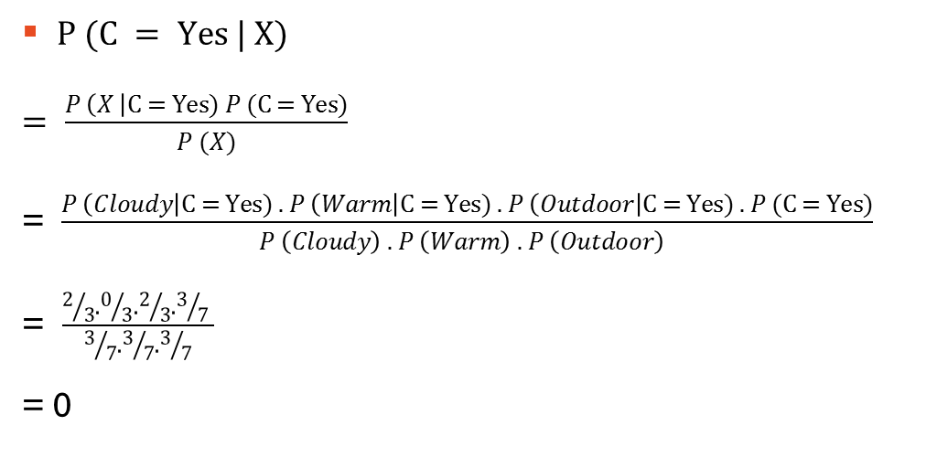
Probability of <wear coat> = yes, if X
$P (C = Yes | X)$
$= \frac{P \left(X \right|C = Yes) P (C = Yes)}{P (X)}$
= $\frac{P \left(Cloudy\right|C = Yes) . P \left(Warm\right|C = Yes) . P \left(Outdoor\right|C = Yes) . P (C = Yes)}{P \left(Cloudy\right) . P \left(Warm\right) . P \left(Outdoor\right) }$
= $\frac{2/3.0/3.2/3.3/7 }{3/7.3/7.3/7}$
= 0
Cognota.ai

Slide 10
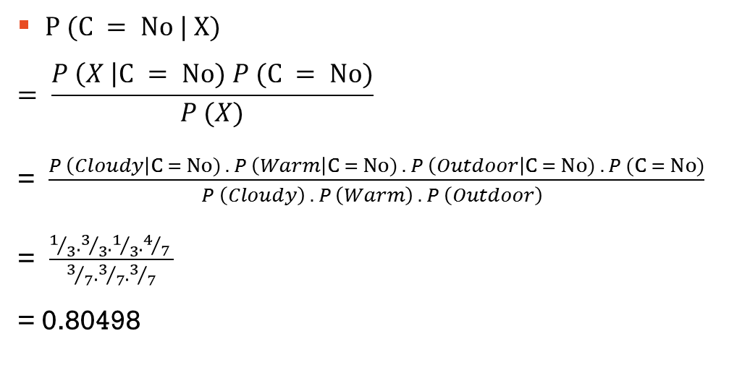
Probability of <wear coat> = no, if X
$P (C = No | X)$
$$= \frac{P \left(X \right|C = No) P (C = No)}{P (X)}$$
= $\frac{P \left(Cloudy\right|C = No) . P \left(Warm\right|C = No) . P \left(Outdoor\right|C = No) . P (C = No)}{P \left(Cloudy\right) . P \left(Warm\right) . P \left(Outdoor\right) }$
= $\frac{1/3.3/3.1/3.4/7 }{3/7.3/7.3/7}$
= 0.80498
Cognota.ai

Slide 11
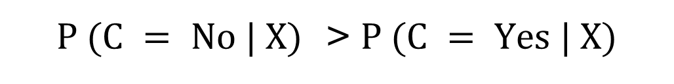
Answer
$P (C = No | X)$ > $P (C = Yes | X)$
Cognota.ai

Slide 12
Implementation Steps
Map categorical options of each features to discrete integers (Ex – Outlook can be Sunny/Cloudy, Replace Sunny with 0 and Cloudy with 1)
Save each feature in a separate vector/numpy array/ list
Save target variable values (wear coat - column) in a separate vector/numpy array/ list
Plug the formulae into your code and replace with proper values (no hardcode, it has to be dynamic)
Finally calculate both the probabilities, and the option with the biggest probability is the answer
Cognota.ai

